Slide 1
FM2200683
[Not Export Controlled/ ECCNxxx]
AIRBUS AMBER
[ADNS Ref] A350 ATA 36 PCE Leakage Monitoring
Feasibility review
Juan Rodríguez
02/04/2024

Slide 2
A350 ATA 36 : PCE Leakage Monitoring
✔
Feasibility review participants
Role | Name & Siglum | Mandatory? | Present? | Comment
Project Leader | David Decouchon | Yes | Yes
Operational expert | Julien Feret | Yes | Yes
Engineering Customer Support (1SY) focal point | Marta Díaz | Yes | Yes
Front-End representative / Airtac representative | Heriniaina Rasolofo | Yes | Yes
Program / support program / Skywise representative | Andy Cheng | Yes | Yes
Health Engineer | Juan Rodríguez Prasanna Raut Akash Jadhav Alejandro Sáez |  | Yes
Design office / EV specialist | Luis Amesty |  | Yes
R&T focal point
Other |  |  | Yes/no
✔

Slide 3
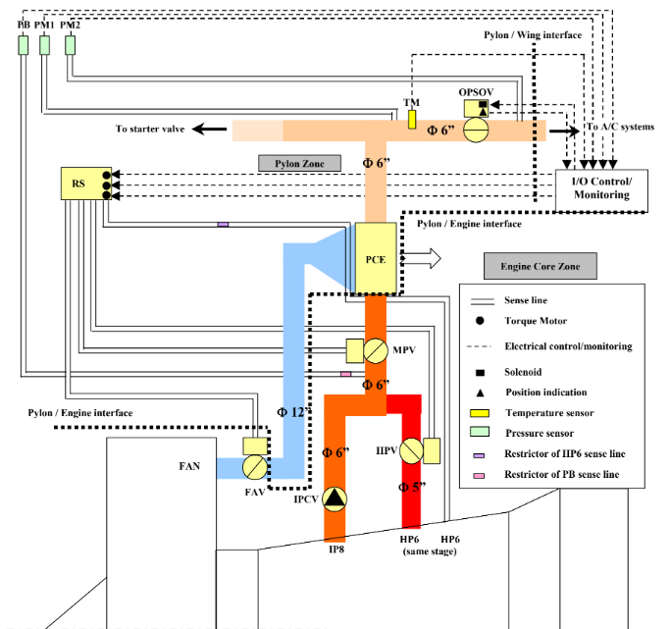
A350 ATA 36 : PCE Leakage Monitoring
System description
Pre-Cooler is used to reduce the temperature of engine bleed, before feeding it to Air Generation Unit.
If hot air leaks from pre-cooler it can damage the other components inside pylon.
No active sensor is available to detect air leak from pre-cooler.
At the end of engine start sequence pressurized air from APU is encapsulated in closed volume as highlighted in the figure.
PM1 sensor can be used to measure the pressure.
Small leaks are normal because the volume is not hermetic and the pressure is reduced gradually. However, in case of leaky PCE the air pressure drops drastically.
PCE
ATA 6D: 36-11-62
FIN: 7150HA1, 7150HA2
PN: 67200000-02
Supplier:HNW Torrance

Slide 4
A350 ATA 36 : PCE Leakage Monitoring
Operational context and model objective
✔
Background:
  Reported damages on ENG Thrust Reverser Thermal Blanket and Pylon Thermal blanket due to PCE leaks.
  TFU 36.11.00129
Root cause:
  PCE accelerated thermal fatigue caused by additional thermal cycles due to IP-HP switchings in cruise phase not foreseen in the design phase.
  PCE leakage velocity above Thermal Blanket qualification levels.
Impact:
  A big leak in the PCE could damage the thermal blankets
Model objective:
  Detect leaky PCE by measuring the depressurization time
✔
Notes:
Flushing process at fuel station ST18 (POE MSN 1971)

Slide 5
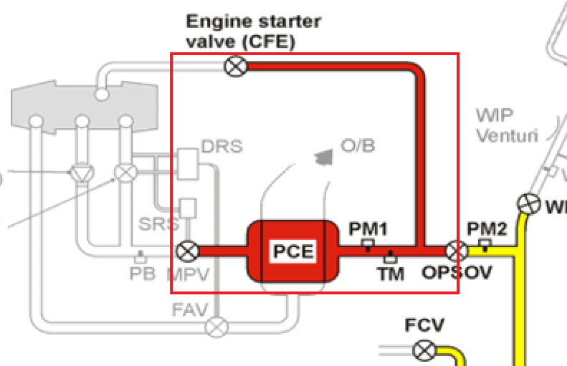
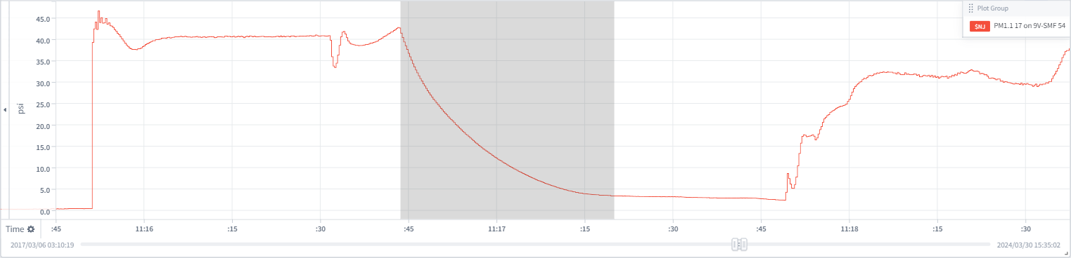
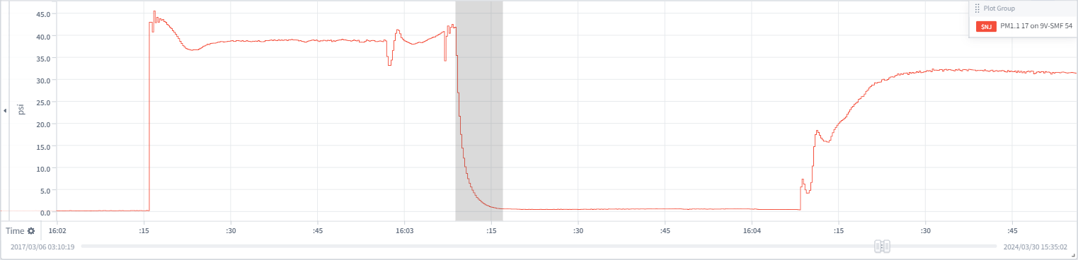
A350 ATA 36 : PCE Leakage Monitoring
Operational context and model objective
✔
MSN 54 SIA
PCE Pressure Decay
(Healthy PCE)
PCE Pressure Decay
(Leaky PCE)
✔
Notes:
Flushing process at fuel station ST18 (POE MSN 1971)

Slide 6
A350 ATA 36 : PCE Leakage Monitoring
Model description
Model Logic
  Monitoring Window:
    15 psig <= PM1 <= 30 psig
    20 psi < HP6 < 80 psi
    HP6(1 minute ago) < 20 psi
    ENG_RUNNING == 1
    ENG_RUNNING(30 seconds ago) == 0
    APU_BV_FULLY_CLOSED == 0
All the depressurizations go through this range of pressures
HP6 pressure was very low 1 minute ago
Engine started less than 30 seconds ago
Air needs to be coming from APU (EBAS isolated)

Slide 7
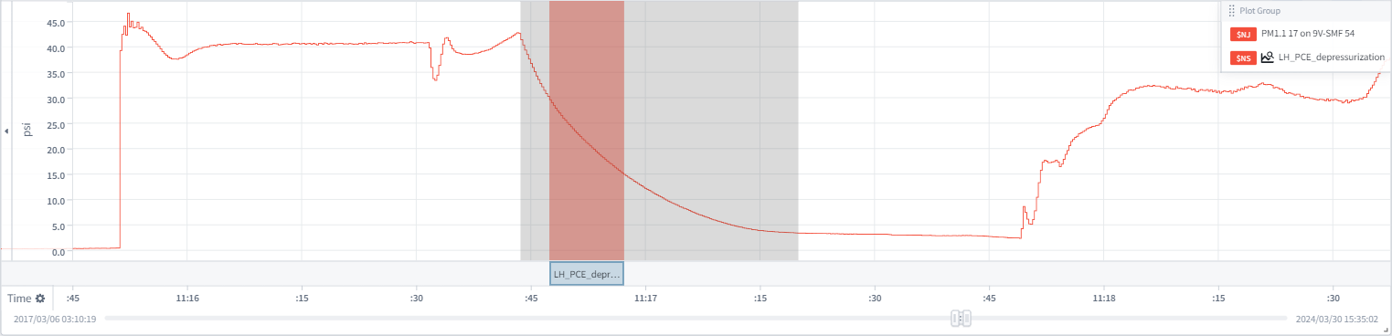
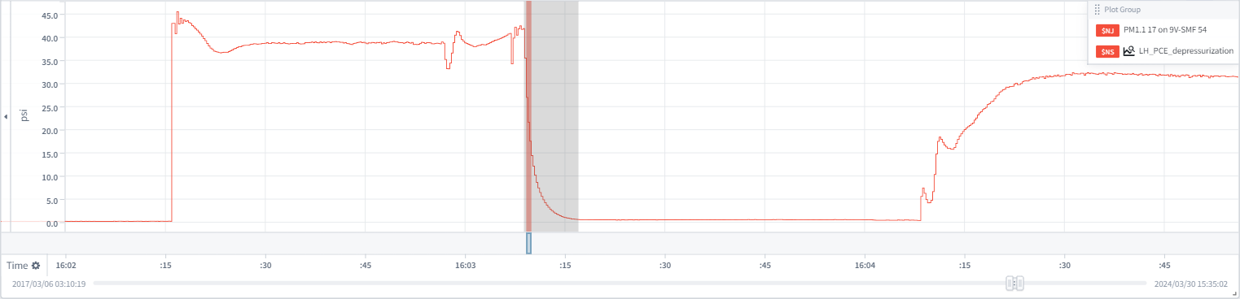
A350 ATA 36 : PCE Leakage Monitoring
Model description
✔
MSN 54 SIA
PCE Pressure Decay
(Healthy PCE)
PCE Pressure Decay
Monitoring Window
PCE Pressure Decay
(Leaky PCE)
PCE Pressure Decay
Monitoring Window
✔
Notes:
Flushing process at fuel station ST18 (POE MSN 1971)

Slide 8
A350 ATA 36 : PCE Leakage Monitoring
Model description
Model Logic
  Monitoring Window:
    15 psig <= PM1 <= 30 psig
    20 psi < HP6 < 80 psi
    HP6(1 minute ago) < 20 psi
    ENG_RUNNING == 1
    ENG_RUNNING(30 seconds ago) == 0
    APU_BV_FULLY_CLOSED == 0
  Features computation:
    event_duration = Monitoring Window duration in seconds
    pressure_drop = PM1_first - PM1_last
    depress_rate = pressure_drop / event_duration
    event_duration_corrected = 15 / depress_rate
  Valid conditions:
    depress_rate > 0 psig/s
    pressure_drop >= 3 psig
    (OPSOV_POS_first == 1) OR (OPSOV_POS_changed == 1)
  Thresholds:
    medium_threshold = 3 seconds
    high_threshold = 1 seconds
  Alerts:
    medium_threshold > event_duration_corrected >= high_threshold
    high_threshold > event_duration_corrected
All the depressurizations go through this range of pressures
HP6 pressure was very low 1 minute ago
Engine started less than 30 seconds ago
Air needs to be coming from APU (EBAS isolated)
Pressure difference between first and last point of the monitoring window
Time it takes to depressurize 15 psig assuming linear pressure decay
Air has to exit the volume
Pressure drop must be significant
OPSOV is closed or closes during monitoring window
(due to low sample rate of the signal)
Medium Leak on PCE (in more than 3 of the last 5 flights)
High Leak on PCE (in more than 3 of the last 5 flights)

Slide 9
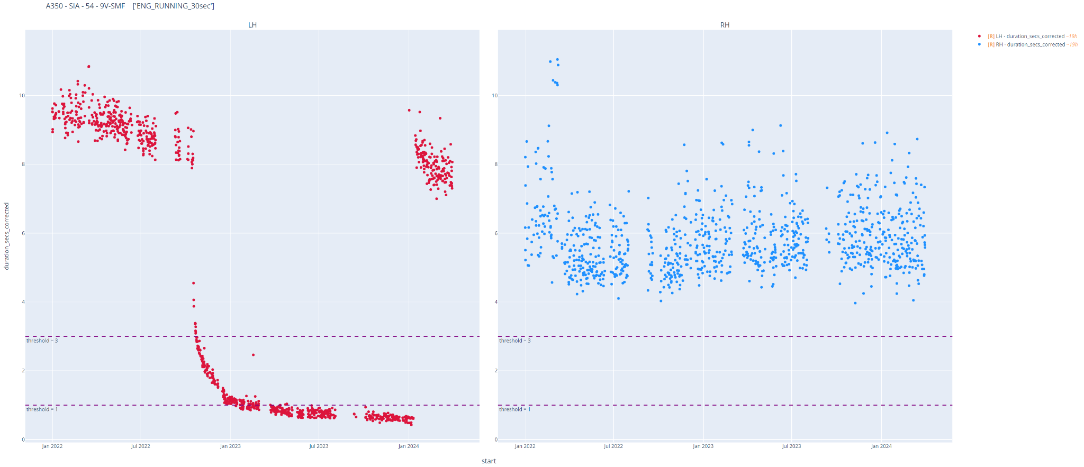
A350 ATA 36 : PCE Leakage Monitoring
Feature plotting
MEDIUM LEAK
ALERT
HIGH LEAK
ALERT

Slide 10
A350 ATA 36 : PCE Leakage Monitoring
Failure statistics - Confirmed events
Airline | MSN | Inspection Date | Inspection findings | Side | Model Alert | Pressure decay duration | Data Source
SIA | 54 | 13/01/2024 | PCE Blanket Damaged | LH | YES | < 1 sec | Skywise SAR
HVN | 14 | 10/09/2023 | PCE Blanket Damaged | LH | YES | < 1 sec | Tech Request SAR
HVN | 14 | 8/03/2023 | PCE Leaky | RH | YES | < 3 sec | Tech Request SAR
HVN | 15 | 30/12/2020 | PCE Blanket Damaged | LH | PROCESSING |  | Tech Request SAR
HVN | 15 | 1/06/2021 | PCE Blanket Damaged | LH | YES | < 1 sec | Tech Request SAR
HVN | 15 | 21/06/2022 | PCE Blanket Damaged | RH | PROCESSING |  | Tech Request SAR
HVN | 17 | 1/11/2022 | PCE Blanket Damaged | RH | PROCESSING |  | Tech Request SAR
HVN | 17 | 21/03/2023 | PCE Leaky | LH | PROCESSING |  | Tech Request SAR
QTR | 42 | 2/04/2024 | PCE Leaky | LH | YES | < 3 sec | Tech Request SAR
QTR | 42 | 2/04/2024 | PCE Blanket Damaged | RH | YES | < 1 sec | Tech Request SAR
All events with available data are detected
Threshold combination | Event Set | Number of events | Number of alerts | Detection rate | Confidence rate
PCE Pressure Decay | Confirmed events with available data | 6 | 6 | 6/6 (100%) | 6/6 (100%)

Slide 11
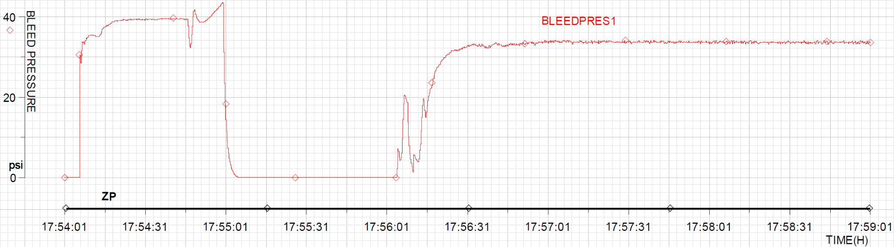
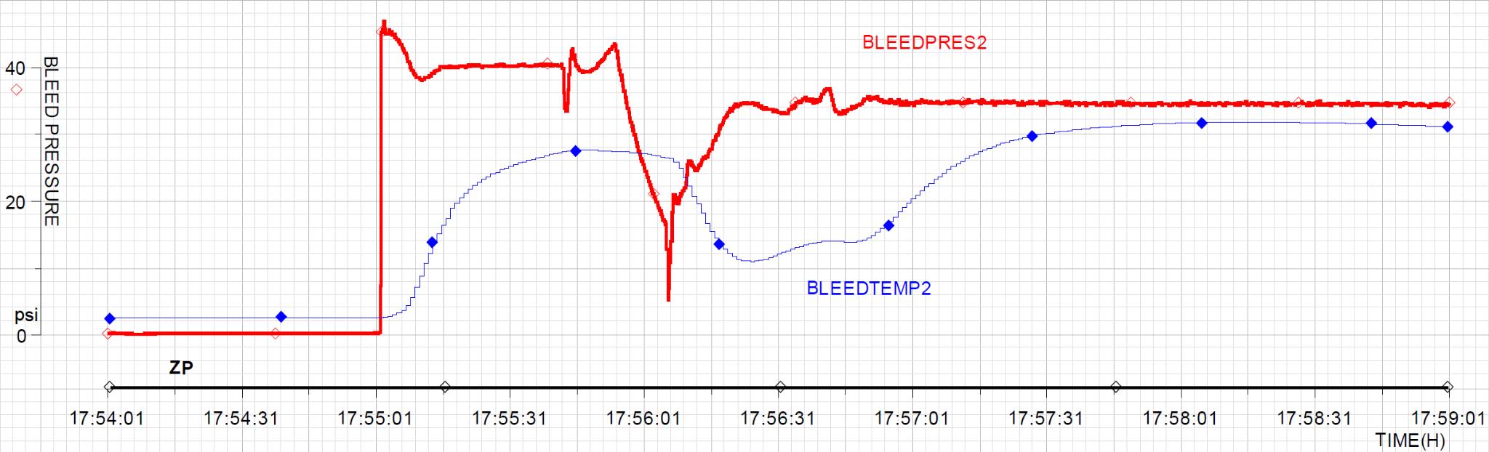
A350 ATA 36 : PCE Leakage Monitoring
Failure statistics - Reference events (TechRequest SAR)
LH PM1
< 1 sec
HVN MSN 14
(07/09/2023)
3 days before inspection.
LH PCE was leaky and blanket was damaged.
RH PM1
~ 6 sec

Slide 12
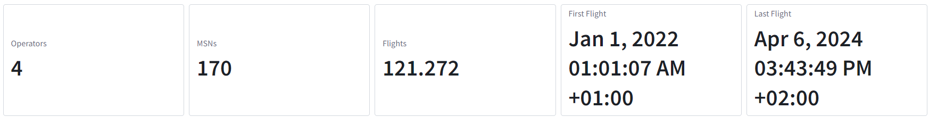
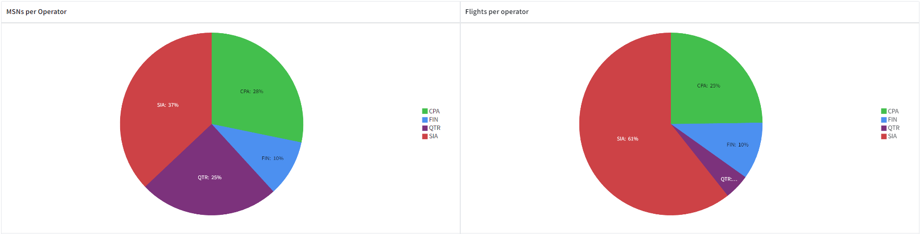
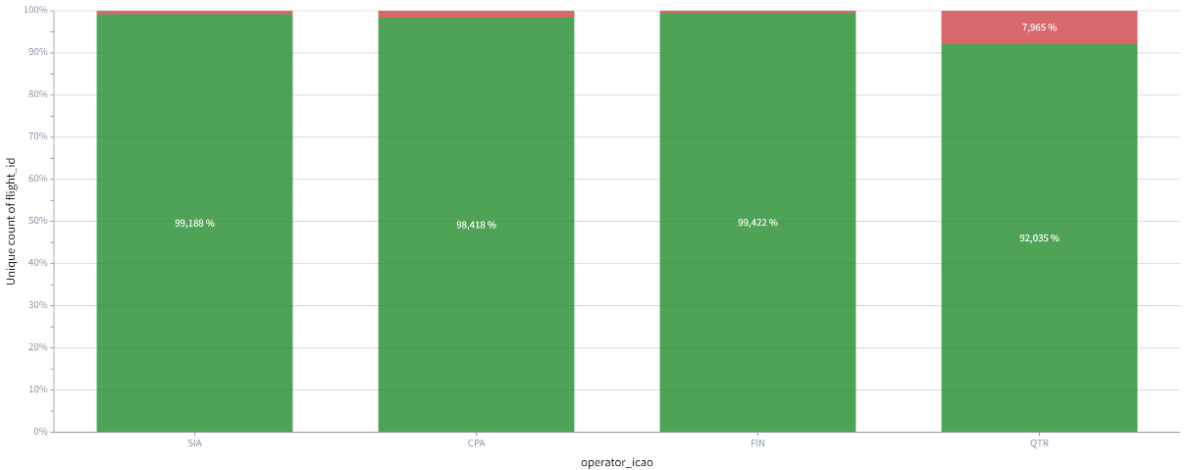
A350 ATA 36 : PCE Leakage Monitoring
Failure statistics - Test set coverage

Slide 13
A350 ATA 36 : PCE Leakage Monitoring
Failure statistics - Skywise alerts
Airline | MSN | Inspection Date | Inspection findings | Side | Model Alert | Alert Date | Data Source
SIA | 54 | 13/01/2024 | PCE Blanket Damaged | LH | YES | 24/10/2022 | Skywise SAR
CPA | 39 | ¿? | ¿? | LH | YES | 15/03/2024 | Skywise SAR
QTR | 10 | May, 2025 | ¿? | RH | YES | 13/01/2024 | Skywise SAR
QTR | 21 | July, 2025 | ¿? | LH | YES | 20/02/2024 | Skywise SAR
QTR | 33 | March, 2025 | ¿? | RH | YES | 02/12/2023 | Skywise SAR
QTR | 47 | June, 2024 | ¿? | LH | YES | 22/11/2023 | Skywise SAR
QTR | 47 | June, 2024 | ¿? | RH | YES | 02/04/2024 | Skywise SAR
QTR | 69 | ¿? | ¿? | LH | YES | 25/02/2024 | Skywise SAR
QTR | 90 | ¿? | ¿? | RH | YES | 29/11/2023 | Skywise SAR
QTR | 132 | December, 2025 | ¿? | RH | YES | 23/11/2023 | Skywise SAR
QTR | 143 | ¿? | ¿? | LH | YES | 22/11/2023 | Skywise SAR
QTR | 143 | ¿? | ¿? | RH | YES | 22/11/2023 | Skywise SAR
Only 12 alerts for 121000 flights
1 confirmed alert, 11 pending inspections
Feature graphs for the 11 pending cases show compatibility with PCE leak

Slide 14
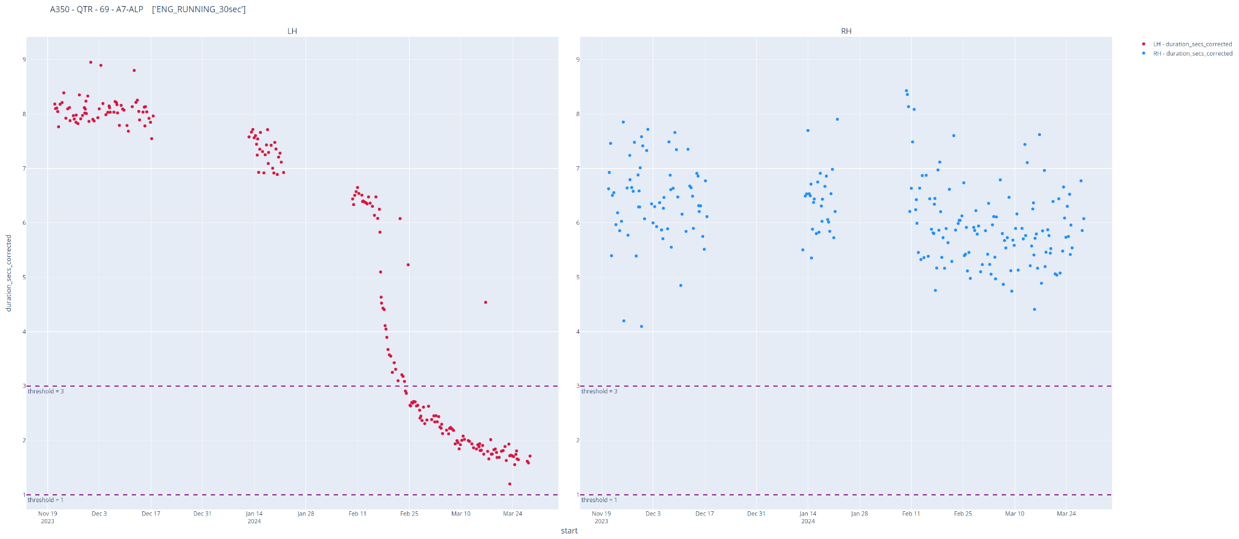
A350 ATA 36 : PCE Leakage Monitoring
Feature plotting
MEDIUM LEAK
ALERT

Slide 15
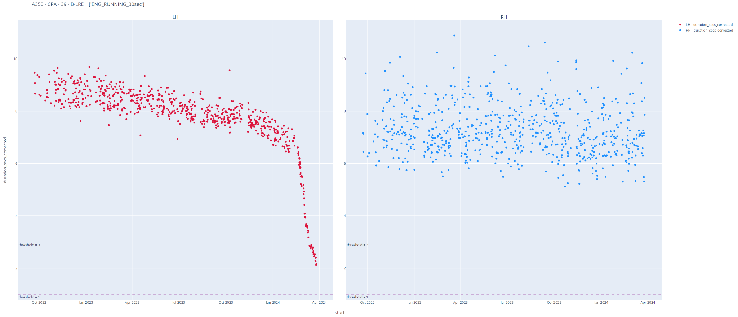
A350 ATA 36 : PCE Leakage Monitoring
Feature plotting
MEDIUM LEAK
ALERT

Slide 16
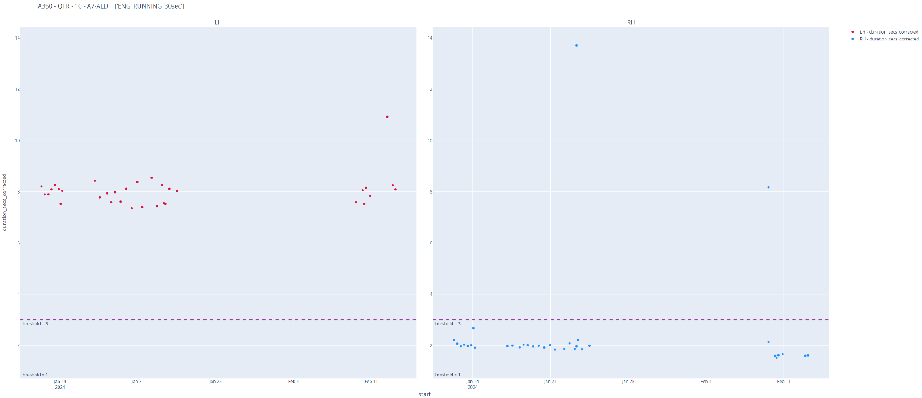
A350 ATA 36 : PCE Leakage Monitoring
Feature plotting
HIGH LEAK
ALERT

Slide 17
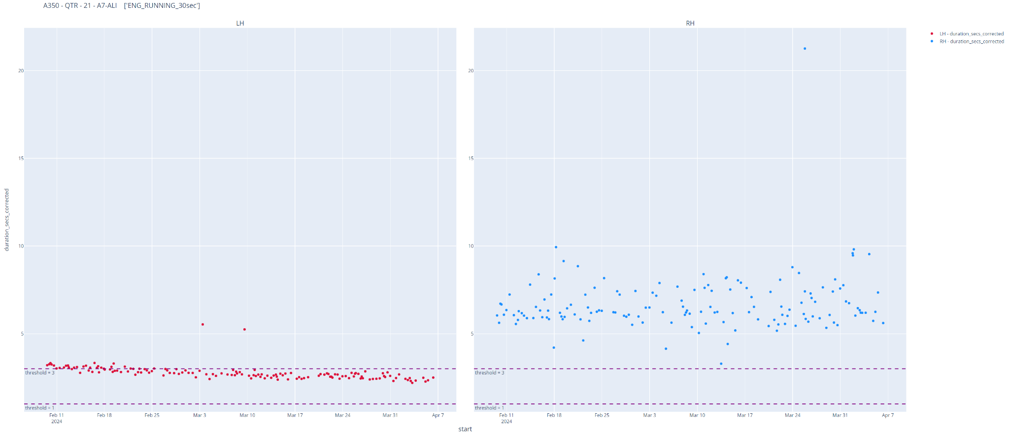
A350 ATA 36 : PCE Leakage Monitoring
Feature plotting
MEDIUM LEAK
ALERT

Slide 18
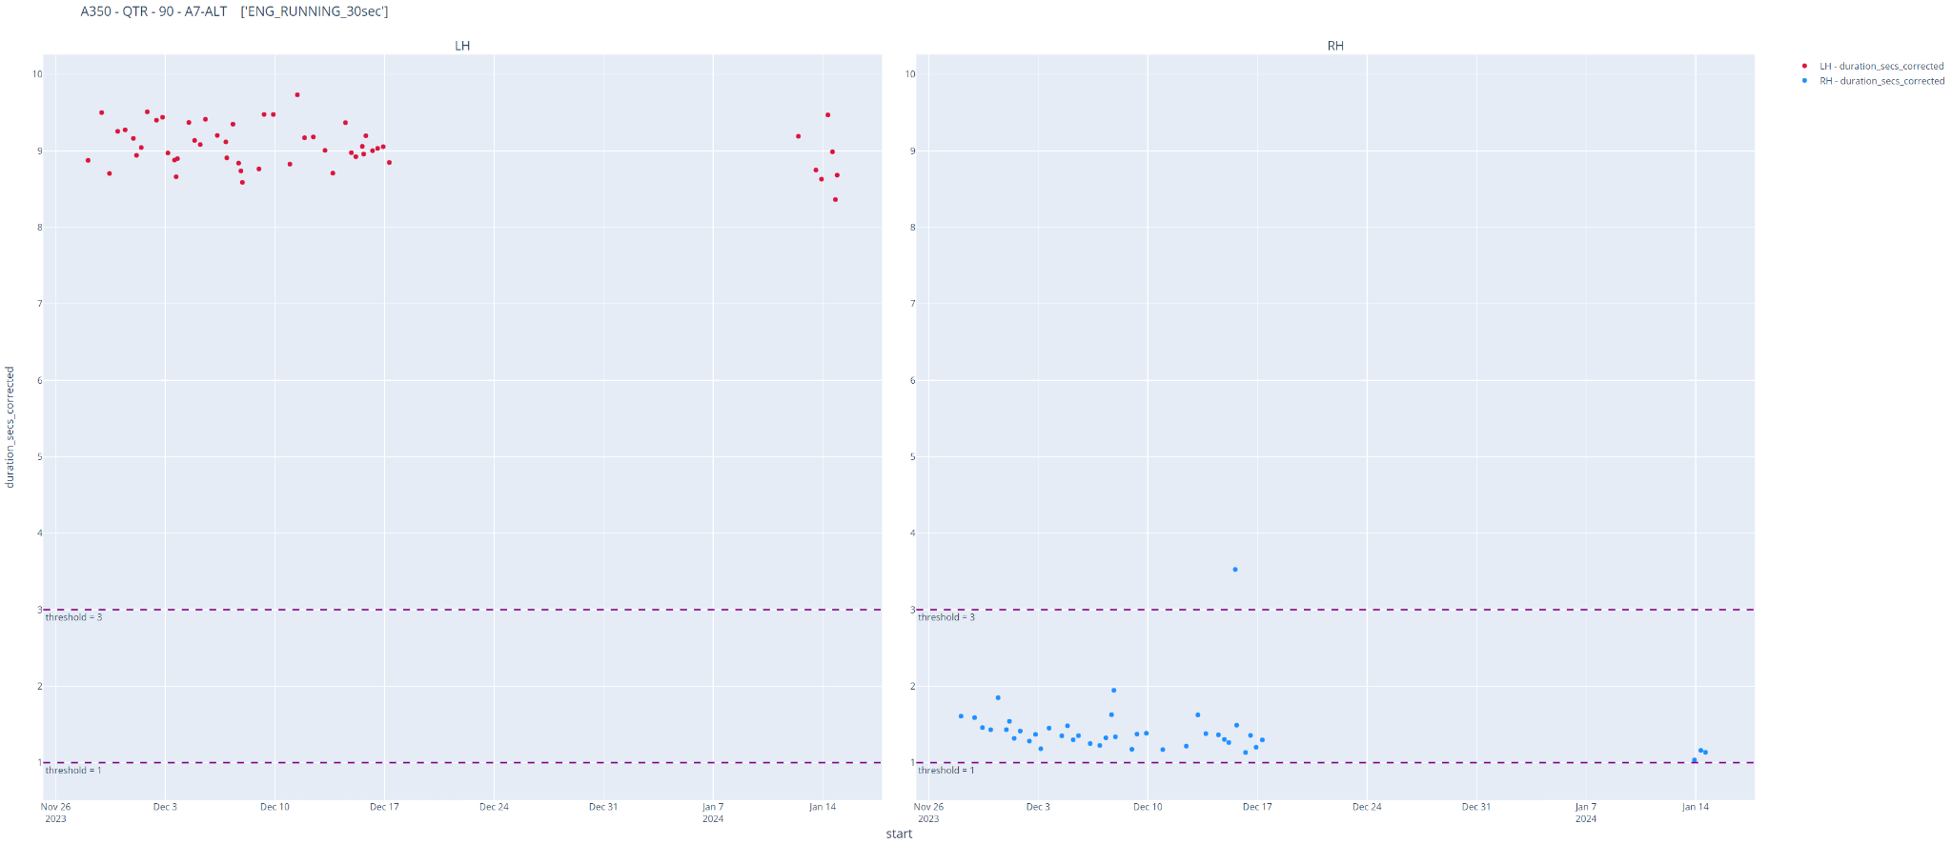
A350 ATA 36 : PCE Leakage Monitoring
Feature plotting
MEDIUM LEAK
ALERT

Slide 19
A350 ATA 36 : PCE Leakage Monitoring
Performance evaluation - main indicator
Threshold combination | Event Set | Number of events | Number of alerts | Detection rate | Confidence rate
PCE Pressure Decay | Confirmed events with available data | 6 | 6 | 6/6 (100%) | 6/6 (100%)
Threshold combination | medium_leak_threshold | high_leak_threshold
PCE Pressure Decay | 3 | 1
Good detection rate based on 6/6 confirmed events with available data.
  Data for 4 additional events is being processed to check the algorithm
Good confidence rate based on feature trend for the 11 alerts with pending PCE inspections.
  PCE inspections will be carried out in the coming weeks as ordered by the AOT A36P010-23 (PCEs with more than 5500 FC have to be inspected)

Slide 20
Performance KPIs description
Note:
Hide this slide during review.
Keep it in review presentation as a reminder.
See also algorithm performance KPIs proposal presentation (starting slide 7):
Main measures (to help airlines make decisions when operating alerts):
  Detection rate: proportion of actual failures that can be detected by the algorithm (in percent).
  Confidence rate: probability that the algorithm is right when predicting a failure (in percent).
  Anticipation time: duration between 1st alert generated by the algorithm and actual failure (in days).
Check min, max, median and distribution.
Secondary measures (to compare ease of use of competing algorithms):
  Lag time: duration between A/C repair and algorithm alerts discontinuation (in days).
A positive lag means that the algorithm was not able to detect part repair or replacement autonomously.
A negative lag means that there was some cut-off, i.e. a premature alert discontinuation before the actual failure.
  Jitter proba: indicates the probability that there is an interruption in algorithm alerting between the first alert and return to normal.
  Gap duration: duration of interruptions in algorithm alerting that have been compensated (thus merging two or more alert periods into a single big alert period).
Check max to make sure merging of distinct alerts was reasonable.

Slide 21
How to use KPIs
Note:
Hide this slide during review.
Keep it in review presentation as a reminder.
Detection rate: the objective is to have it as high as possible while staying good on other KPIs (especially confidence rate)
Confidence rate: should be 100%
  If not possible then the acceptable confidence rate level should be agreed with the Front End.
  Note: in some cases confidence rate may be adversely affected by jitter. You might want to check curves to know if confidence rate is due to real spurious alerts or just to jitter. Increase jitter_tol in the latter case.
Anticipation time: expected anticipation level must be agreed with Front End (typically 1 week).
Lag: must be < 1. (Lag is computed between reference event and first flight without alert after the event)
  A lag of 1 may result from the tolerance added when computing KPIs to compensate for cases where only the date is available for events (and not the exact time of the repair).
  If a lag < 1 cannot be achieved (typically the model cannot detect unit replacement by itself), then you will need to use the SPM model reset feature on maintenance actions declared by airlines.
  A positive lag may also result from the airline operating for some time with the failure still present (in case of MEL application for instance) and/or from the choice of reference event date.
Jitter probability: Ideally it should be kept as low as possible. However some jitter is acceptable.
Cut off probability: should be 0% or as small as possible.
  If the health indicator is closely correlated to equipment status, then it should steadily display a degraded state when approaching a removal.
  However, noise may be your enemy and may result in an alert that stops triggering some time before the airline fixes the issue.

Slide 22
Tools
Note:
Hide this slide during review or remove it.
You can use any of the following tools to assess the performance of predictive maintenance algorithms:
YuCCon module directly within your python code during preliminary design phase,
Refer to:
      The tutorial provided within YuCCon GitHub repository.
      YuCCon documentation in Confluence.
Model Perfo Tools within Foundry (recommended when assessing alerts generated by an SPM model).
Refer to:
      Confluence page on “Assessing Algorithm Performance using Code Workbook”.

Slide 23
A350 ATA 36 : PCE Leakage Monitoring
Performance evaluation - example
Show an example of real event with the associated model alert (curves)

Slide 24
A350 ATA 36 : PCE Leakage Monitoring
Business value (optional)
Expected maintenance action required in case of alert
Expected saving per alert (based on average delay, equipment DMC increase, fuel consumption increase …)
Expected cost per alert
Expected benefit depending on the fleet size

Slide 25
A350 ATA 36 : PCE Leakage Monitoring
Expected benefits simplified computation method
DRAFT
Compute the expected number of occurrences for one airline
np = Nb of aircraft in airline fleet x Nb of years considered x failure occurrence rate for the entire fleet found during targeted event search
Note: Nb of years considered should be set equal to 1 (maximum 3 as this is the horizon on which airline assess return on investment)
Check if algorithm is a good candidate for deployment
  If np < 1.5, do not deploy the model to the airline (there is a high chance it will never trigger)
  If 1.5 <= np <= 3, model may be deployed to the airline provided it has no spurious (any spurious will result in a non negligible chance of loss for the airline)
  If 3 <= np <= 9, model can be deployed to the airline. A certain level of spurious may be acceptable. To be determined using the simulator.
  If np >= 9 you can estimate benefits directly from the following formula:
Business value = ("single failure avoidance savings" x "yearly failure detection rate per A/C" - "spurious troubleshooting cost" x "yearly spurious rate per A/C") x "assessment period" (in years)

Slide 26
A350 ATA 36 : PCE Leakage Monitoring
Feasibility review conclusion
✔
Interest for the model / Business interest?
Acceptable performance?
GO / NO for SPM / SHM development
GO
Actions:
  Work in anticipation time (Juan Rodríguez)
  Collect SAR data for 2024 airlines to correctly manage the spares.
  Increase SAR collection of JAL or add ADC.
  Anticipate an ACMS Report for the monitoring to be fleet wide in 2025. (Juan Rodríguez)
✔

Slide 27
Guidelines
Back to BP & LL slides
Useful links
confluence page
dataset ( CMS / logbook / SPM workflow / removal dataset)
ango library
Extended platform template
Performance evaluation library
TechRequest dataset ->
example of feasibility review

Slide 28
Proposed algorithm performance measures
Main measures (to help airlines make decision when operating alerts):
  Detection rate: proportion of actual failures that can be detected by the algorithm (in percent).
  Confidence rate: probability that the algorithm is right when predicting a failure (in percent).
  Anticipation time: duration between 1st alert generated by the algorithm and actual failure (in days).
Secondary measures (to compare ease of use of competing algorithms):
  Lag time: duration between A/C repair and algorithm alerts discontinuation (in days).
  Jitter: interruption in algorithm alerting between the first alert and return to normal (probability and gap duration).
  Cut off: premature alert discontinuation before part is replaced or deactivated under MEL.
Additional measures (to serve as inputs for business value computation):
  Savings event probability per aircraft per year.
  Spurious event probability per aircraft per year.

Slide 29
Algorithm performance assessment by prototyping on historical data
Main measures
Detection rate (recall):
Probability of detecting an existing failure in percent.
Confidence rate (precision):
When an alert triggers, probability that it is useful (i.e. not a spurious) in percent.
Detection rate =
Nb of detected failures
Confidence rate =
Nb of useful alerts
Total number of failures
Total number of alerts
Useful alert
Spurious alert
✔
✔
⛌
⛌
Alert status
Useful alert
Detected event
Alert status
Spurious alert
Undetected event
Triggers
Triggers
No alert
No alert
Time
Time
Event falls within the alerting period.
Alerting period

Slide 30
Algorithm performance assessment by prototyping on historical data
Main measures
Anticipation time:
Time between the beginning of the alerting period and detected failure event, in days.
Lag time:
Time between detected failure event (assumed repaired immediately) and the end of the alerting period, in days.
Anticipation measure
Lag measure
✔
✔
✔
✔
Alert status
Useful alert
Detected event
Alert status
Useful alert
Detected event
Triggers
Triggers
No alert
No alert
Time
Time
Anticipation time
Lag

Slide 31
Algorithm performance assessment by prototyping on historical data
Handling jitter
Jitter probability:
When an alert triggers, probability that it is discontinued by a jitter occurrence.
Default jitter tolerance is 15 days. Beyond, alerts are not merged.
Nb of extended alerts with at least one jitter case
Jitter proba =
Total number of extended alerts
Jitter effect
Jitter compensation
⛌
✔
✔
Old alerts replaced by extended alert.
✔
✔
Alert status
Spurious alert
Useful alert
Detected event
Alert status
Useful alert
Detected event
Triggers
Triggers
No alert
No alert
Time
Time
Jitter gap
Anticipation time
Early alert considered as spurious.
Lowers confidence rate.
Jitter case added to jitter statistics.

Slide 32
Algorithm performance assessment by prototyping on historical data
Handling early cut off
Cut off probability:
When an alert triggers, probability that it stops before the event occurs on aircraft.
Default cut off tolerance is 0 days.
Nb of alerts that stop before event occurrence
Cut off proba =
Total number of alerts
Cut off effect
Cut off compensation
⛌
⛌
✔
✔
Alert status
Spurious alert
Undetected event
Alert status
Useful alert
Detected event
Triggers
Triggers
No alert
No alert
Time
Time
Alerting stops too early (“cut off”).
Cut off time
Tolerance added at end of alerting period to compensate for cut off.

